Slide 1
Sustainable Finance
Introductory theory: Economics

Slide 2
How you will be marked
30% group assignment
70% continuous individual project
Submission folders in Teams for both assignments
Deadlines to be announced (usually group assignment after the mid of the classes and individual right after the end of the term)

Slide 3
Individual Assignment
Individual Assignment (max 30 pages)
Suppose you are the CEO of a big company in France which is listed in the stock exchange.
• Describe your company and the business activities (max 3 pages).
• Prepare in detail the Organogram of your Company (1 page).
• Describe the Bord of the Directors (BoD) (max 2 pages).
• Prepare a hypothetical Balance Sheet and Income Statement for two years with the most possible detail. (max 2 pages)
Your CFO (or CVO) informs you that ESG is a very important EU policy, and you should align your business operations with ESG principles.
• Based on ESG pillars try to develop new policies for the different activities of your company. Describe your activities related to these new policies (max 5 pages).
• Evaluate the level of Corporate Governance for your company and suggest improvements (max 5 pages).
• Prepare a short sustainability report on an “as if” basis (max 5 pages).
• Examine green bonds as a source of finance. Write a short report on how you would be able to issue green bonds (max 2 pages).
• Imagine you must organize the annual meeting of the shareholders. Explain in detail how you will do that (max 3pages).
• There are some negative reports that your company is using “greenwashing”. Defend your company’s position (max 2 pages).

Slide 4
Group Assignment
Group Assignment
Visit the web sites and open the related documents.
https://www.euronext.com/en/about/esg-empowering-sustainable-growth/euronext-esg-policies-statements
https://www.esma.europa.eu/sites/default/files/library/esma22-106-1301_smsg_advice_on_sustainable_finance.pdf
https://www.esma.europa.eu/sites/default/files/library/esma22-105-1052_sustainable_finance_strategy.pdf
https://www.esma.europa.eu/document/joint-esas-opinion-assessment-sustainable-finance-disclosure-regulation-sfdr
https://www.esma.europa.eu/document/opinion-functioning-sustainable-finance-framework
Make a summary of the things covered in these documents and explain why ESG is important for the European economy. Critically evaluate the sustainability policies described in the documents. (max 10 pages).

Slide 5

Sustainable Finance
https://youtu.be/JdWQJq2OkJs

Slide 6

Definitions
Sustainable (adjective) : able to continue over a period of time.
Sustainability is a societal goal with three dimensions (also called pillars): the environmental, economic and social dimension. This concept can be used to guide decisions at the global, national and at the individual consumer level. A related concept is that of sustainable development. Both terms are often used synonymously. UNESCO formulated a distinction as follows: "Sustainability is often thought of as a long-term goal (i.e. a more sustainable world), while sustainable development refers to the many processes and pathways to achieve it.

Slide 7

Definitions
Economy – “oikonomos” (Greek)
To manage-rule a household (oikos)
Households and Society - many decisions
Allocate scarce resources (political decision)
Maximize output (technical decision)
Allocate output (political decision)

Slide 8

Economics Background
Economics is often referred to as the "science of scarcity" as it explores how societies allocate limited resources to fulfill unlimited (not really unlimited but a lot) wishes and needs. It encompasses the study of production, distribution, and consumption of goods and services, as well as the behavior of individuals, businesses, and governments in making economic decisions.

Slide 9
Economics Background
Foundations of Economics:
Scarcity and Choice: At the core of economics lies the concept of scarcity, which arises from the inherent limitation of resources relative to human needs. As a result, individuals and societies must make choices about how to allocate scarce resources efficiently to maximize individual and collective utility and satisfaction.
Supply and Demand: The interaction of supply and demand in markets determines prices and quantities of goods and services. Supply represents the quantity of a good or service that producers are willing to offer at different prices, while demand reflects the quantity that consumers are willing to purchase at various price levels. Equilibrium occurs when supply equals demand, setting the market price and quantity.

Slide 10

Economics Background
Methodology of Economics:
Microeconomics: Microeconomics focuses on the behavior of individual agents, such as consumers, producers, and firms, and their interactions in specific markets. It analyzes how decisions regarding production, consumption, and pricing are made and how they affect resource allocation and market outcomes.
Macroeconomics: Macroeconomics examines the economy as a whole, studying aggregate phenomena such as inflation, unemployment, economic growth, and fiscal and monetary policies. It seeks to understand the factors influencing the overall level of economic activity and how policymakers can influence economic variables to achieve macroeconomic objectives.

Slide 11
Economics Background
Economics intersects with various disciplines, including sociology, psychology, political science, and mathematics, to provide a comprehensive understanding of economic phenomena. Behavioral economics integrates insights from psychology to study how individuals' cognitive biases and heuristics influence economic decision-making, while econometrics employs statistical methods to analyze economic data and test economic theories empirically.

Slide 12
Economics Background
Economics serves as a powerful tool for analyzing and understanding complex economic systems and human behavior. By applying rigorous methodologies and theoretical frameworks, economists seek to address real-world challenges and inform policy decisions to promote economic prosperity, social welfare, and sustainable development. As a dynamic and evolving field, the science of economics continues to evolve, adapting to new realities and advancing our understanding of the intricacies of the economic world.
Nevertheless, economic theory is based on assumptions. The quality if assumptions is important when we test and develop economic theory.
Examples of assumptions: rational agents, zero transaction costs, zero taxes, perfect information, no barriers etc.

Slide 13

Economics Background
Theory is a simplification of reality.

Slide 14

Economics Background
Economists study:
How people make decisions (give examples)
How people interact with one another (give examples)
Analyze forces that affect the economy (endogenous and exogenous)

Slide 15
Economics Background
Individuals, families and society face choices when decide.
Individual (eat this or that, work/rest, consume/save)
Family (vacations/no vacations, buy a house/rent)
Society (produce health care/education/defense, high production/pollution, social equality)

Slide 16
Economics Background
Efficiency and equality
Efficiency
getting the most output from given resources
For a given output use the less possible resources
Equality
Distributing output equally among the members of society. Give equal opportunities.

Slide 17
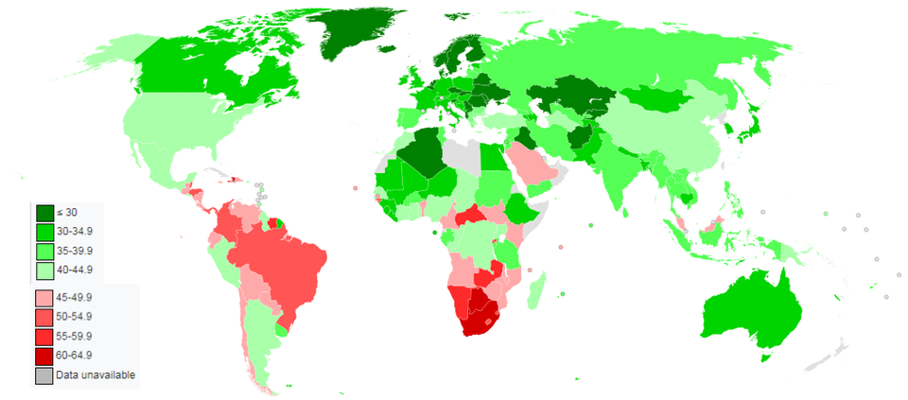
Equality: Gini coefficient
In economics, the Gini coefficient , is a measure of statistical dispersion intended to represent the income in equality or the wealth inequality within a nation or a social group. The Gini coefficient was developed by the statistician and sociologist Corrado Gini. The Gini coefficient measures the inequality among values of a frequency distribution, like the levels of income. A Gini coefficient of 0 expresses perfect equality, where all values are the same (i.e. where everyone has the same income) while a Gini coefficient of 1 (or 100%) expresses maximal inequality among values (i.e. for a large number of people where only one person has all the income or consumption and all others have none, the Gini coefficient will be nearly one).

Slide 18
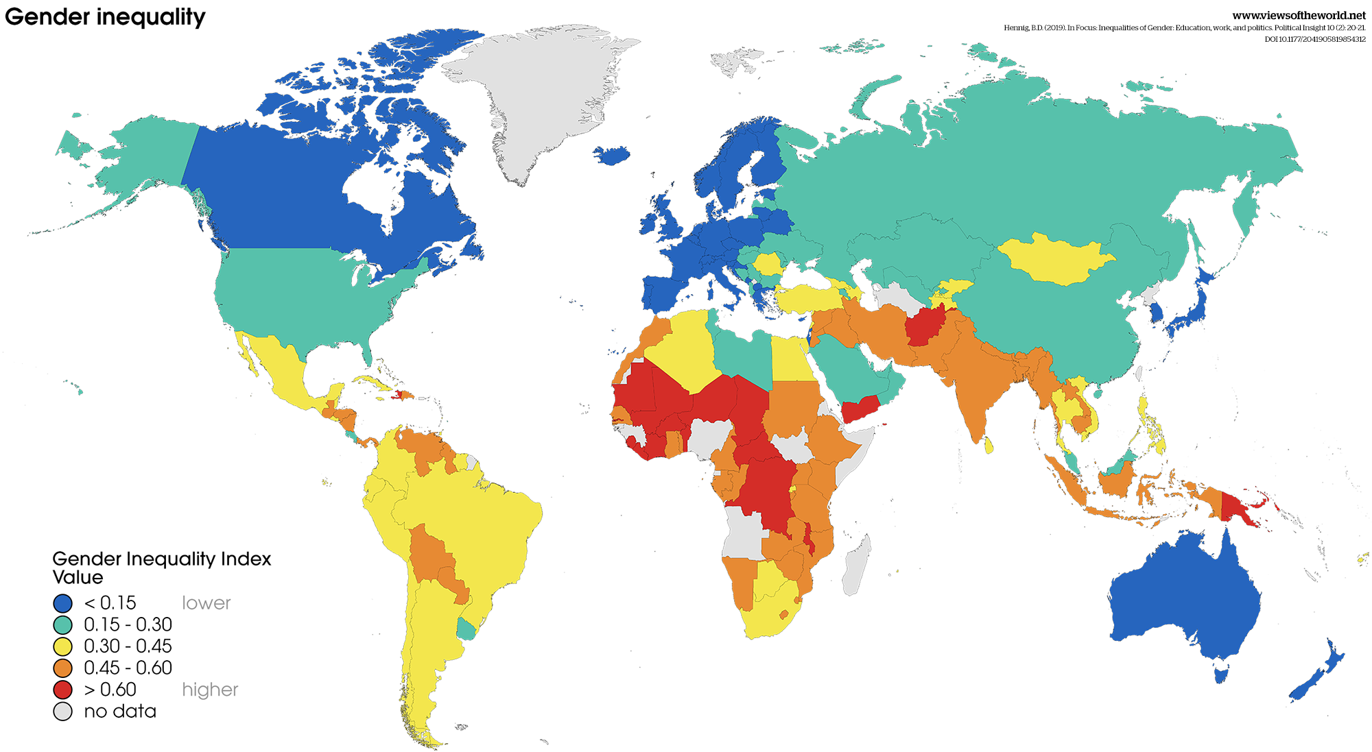
Equality: Gender equality

Slide 19
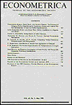
Economic actors: All of us
Rational Expectations and the Theory of Price Movements
John F. Muth
Econometrica
Vol. 29, No. 3 (Jul., 1961), pp. 315-335 (21 pages)
Published By: The Econometric Society
The Homo Economicus
Rational decision maker – rational means acting according to the predictions of the economic theory, Muth (1961).
Not influenced by sentiment and makes no systematic mistakes but only random.
All people are utility maximizers
All we have needs/wishes we want to maximize

Slide 20
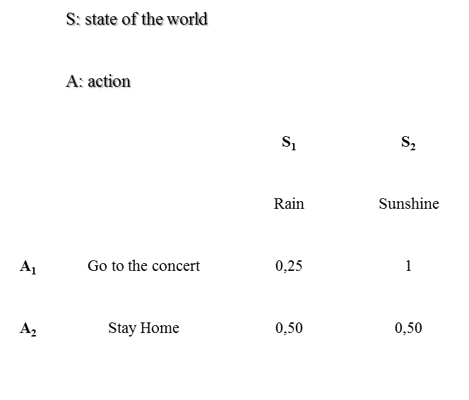
How we decide?
Economic decisions

Slide 21
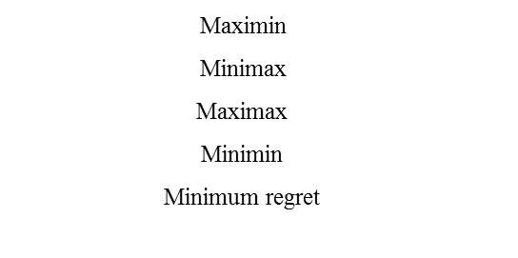
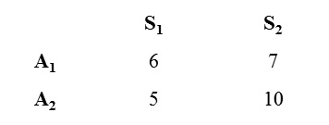
Economic decisions
Economic decisions

Slide 22

Group Activity 10 min
Each member of the group explain to the other members a decision he/she took today, and the criteria used for taking this decision.

Slide 23
How we decide? Expected value.
Decisions based on expected value

Slide 24
How we decide? The St. Petersburg paradox
How we decide? Expected value.

Slide 25
Expected utility and not expected value
The idea is that the "benefits", "utility", or "pleasure" of the individual when receives a profit differs from the size of profit, and that people are interested in the expected utility of profits of asset and not for the expected value of the profits. Bernoulli has mentioned "the determination of the value of an asset should not be based on price but on the utility that gives. There is no doubt that the profit of one thousand ducats is more important for a poor compared to a rich even though they both earn the same amount."
25

Slide 26
How we decide? Expected utility.
Decisions based on expected utility

Slide 27
Expected Utility

Slide 28
How we decide? Prospects or lotteries
Axioms:

Slide 29
Graphical representation of a utility function

Slide 30
Graphical representation of a utility function
The decision rule for determining an individual’s risk preferences from her utility function is as follows:

Slide 31
Expected Utility
Example: Maria has a lottery, say A, with a 50% probability of winning 10,000 and a 50% probability of winning nothing. The expected value (EV) of this lottery is be the average of the payoffs weighted by their corresponding probabilities. The EV of A is 5,000.
The EU weighs the utility of the payoffs and not the payoffs themselves. Therefore, one needs to attach the payoffs into the utility function of an individual first. Assume an individual, say Maria, with the utility function U(w) = w^1/2. So, Maria derives 100 ‘utils’ from the payoff of 10,000, and 0 ‘utils’ from the payoff of 0. Having calculated the utility of each payoff, we can now weigh them (that is 100 and 0) by their probabilities (that is 0.5 and 0.5) to get the expected utility of the lottery. It follows that EU(A) = 50, meaning that Maria’s predicted utility value of the lottery is 50 ‘utils’.

Slide 32
Expected Utility
Now suppose that Maria could receive a “sure thing” of 5,000 instead of participating in lottery A. This “sure thing” which we offer Maria is equivalent to the average payout, i.e. the ‘expected value’, of the lottery.
But what would be Maria’s utility from a “sure thing” paying her 5,000 with certainty? For this we need to attach the 5,000 into her utility function, which gives U(5,000) = 70,71.

Slide 33
Expected Utility
The result should be surprising: lottery A and the “sure thing” have the same expected value of 5,000. Yet Maria derives a higher utility from the “sure thing” than from the lottery.
This leads us to the concept of risk aversion. Expected utility theory accounts for the risk preferences of individuals and categorises them as either risk-averse, risk-neutral or risk-seeking.
This is important, because people tend to be risk-averse in decisions involving gambling. Maria preferred the “sure thing” because she has risk-averse preferences. What is more, one can immediately see that Maria is risk-averse when examining her utility function in more detail. In particular, the parameter ‘a’ in the utility function defines an individual’s risk preferences. Because a is assumed to be 0.5 in Maria’s case, her utility function exhibits diminishing marginal utility of wealth, which is equivalent to saying that she is risk-averse.

Slide 34
Expected Utility
But what does diminishing marginal utility of wealth mean exactly?
It means is that a one-unit increase in an individual’s wealth yields a higher marginal utility, i.e. a higher increase in utility, at low levels of wealth compared to an equal-sized wealth increase at high levels of wealth. One might think of it like this: a one-unit increase in wealth matters a lot if an individual has no wealth at all but the same one-unit increase is negligible for individuals with a wealth of 1,000,000.
A risk-averse individual like Maria has a convex utility function. She prefers the sure thing over the gamble. A risk-neutral individual does not care about risk. The utility she derives from the gamble and the sure thing are the same and her utility function is a straight line. A risk-seeking individual has a concave utility function. She prefers the gamble over the sure thing.

Slide 35
Graphical representation of a utility function

Slide 36
Goods and bads

Slide 37

Goods and bads
Understanding Goods and Bads in Economics
In the realm of economics, goods and bads are two fundamental concepts that represent the tangible and intangible outcomes of economic activities. While goods are tangible products and services that provide utility or satisfaction to consumers, bads refer to undesirable outcomes or externalities associated with economic production and consumption. This document aims to explore the characteristics, classifications, and implications of goods and bads in economics.

Slide 38
Goods and Bads
Goods: Goods are items or services that are tangible, consumable, and transferable, capable of satisfying human wants and needs. They are typically classified into two main categories:
Tangible Goods: Tangible goods are physical products that can be touched, seen, and stored. Examples include food, clothing, electronics, furniture, and vehicles. Tangible goods are often traded in markets, and their production and consumption contribute to economic growth and development.
Intangible Goods (Services): Intangible goods, also known as services, are non-physical products that provide benefits to consumers. Services encompass a wide range of activities, including healthcare, education, transportation, banking, entertainment, and consulting. Unlike tangible goods, services are consumed at the point of production and are often characterized by perishability and variability.

Slide 39
Goods and Bads
Bads: Bads, on the other hand, represent negative or undesirable outcomes associated with economic activities, often resulting in harm or detriment to individuals, society, or the environment. Bads can manifest in various forms and are typically classified into two categories:
Environmental Bads: Environmental bads refer to negative externalities or adverse effects on the environment resulting from economic production and consumption. Examples include air and water pollution, deforestation, habitat destruction, climate change, and depletion of natural resources. Environmental bads impose costs on society in the form of health impacts, ecosystem degradation, and economic losses.
Social Bads: Social bads encompass adverse social outcomes or externalities arising from economic activities that harm individuals or communities. Examples include poverty, inequality, discrimination, crime, substance abuse, and social unrest. Social bads undermine social cohesion, well-being, and quality of life, perpetuating socio-economic disparities and injustices.

Slide 40
Goods and Bads
Implications:
Market Failures: Goods and bads can lead to market failures, where the allocation of resources by markets fails to maximize social welfare. Market failures occur when the prices of goods and services do not reflect their full social costs or benefits, resulting in overproduction of goods with negative externalities (bads) and underproduction of goods with positive externalities (goods).
Policy Interventions: To address the negative externalities associated with bads and promote the production and consumption of goods with positive externalities, policymakers often intervene through regulatory measures, taxation, subsidies, and public policy initiatives. Environmental regulations, social welfare programs, and public health interventions are examples of policy interventions aimed at mitigating the adverse effects of bads and enhancing societal well-being.

Slide 41
Needs and wishes

Slide 42
Needs and Wishes
Distinguishing Between Needs and Wishes
In our daily lives, we often encounter various desires and aspirations, ranging from essential necessities to frivolous wants. Distinguishing between needs and wishes is crucial for making sound decisions, managing resources effectively, and prioritizing our actions. This document aims to explore the differences between needs and wishes, highlighting their significance in personal finance, goal-setting, and decision-making.

Slide 43
Needs and Wishes
Defining Needs and Wishes:
Needs: Needs are essential requirements for survival, well-being, and basic functionality. They are things that are necessary for sustaining life, maintaining health, and meeting fundamental human needs. Examples of needs include food, water, shelter, clothing, healthcare, and education.
Wishes (Wants): Wishes, also known as wants, are desires or preferences that are not essential for survival but are driven by personal preferences, aspirations, or societal influences. Wishes often relate to comfort, convenience, enjoyment, and self-expression. Examples of wishes include luxury goods, entertainment, travel, hobbies, and non-essential possessions.

Slide 44
Needs and Wishes
Key Differences:
Essentiality: Needs are essential for survival and basic functioning, whereas wishes are optional and discretionary.
Prioritization: Needs take precedence over wishes in terms of importance and priority. Meeting needs is necessary before fulfilling wishes.
Impact on Well-being: Satisfying needs contributes directly to well-being, health, and quality of life, whereas fulfilling wishes enhances comfort, enjoyment, and personal satisfaction.

Slide 45
Needs and Wishes
Implications for Decision-Making:
Resource Allocation: Distinguishing between needs and wishes helps individuals allocate their resources, such as time, money, and energy, more effectively. Priority should be given to meeting needs before indulging in wants.
Budgeting and Financial Planning: Needs form the foundation of budgeting and financial planning, as they represent essential expenses that must be covered to maintain a reasonable standard of living. Wishes are discretionary expenses that can be adjusted based on available resources and financial goals.
Strategies for Balancing Needs and Wishes:
Establishing Priorities: Prioritize needs over wishes when allocating resources and making spending decisions. Ensure that essential needs are met before allocating funds to discretionary wants.
Setting Goals: Set specific financial goals and objectives that align with both needs and wishes. Establishing clear goals helps prioritize spending, save for future needs, and allocate resources more effectively.

Slide 46
Utility and indifference curves

Slide 47

Utility and Indifference Curves. How to Measure Utility?
Ordinal rankings
give us information about the order in which a consumer ranks preferences. For example, we may prefer A to B (goods) but an ordinal ranking would not tell us how much more we may like A to B.
Cardinal rankings
can also measure the degree of our preference for A to B and we can quantify this e.g. ”we prefer A twice as much as B.” Use of utils……

Slide 48
Group Activity 10 min
Give 5 examples of ordinal and 5 examples of cardinal utility.

Slide 49
Marginal Utility
Expresses how the level of utility will change (∆U) in response to a change in the level of consumption (∆A, where ∆ is the symbol for change ).
Marginal utility is the utility a consumer derives from the extra unit of consumption of a good or a service.
Graphically, the marginal utility at a particular point is represented by the slope of a line that is tangent to the utility function at that point.

Slide 50
Marginal Utility
As more and more of a good is consumed by a consumer, the marginal utility of additional units starts to fall. The same happens with money!!!
The idea is that the "benefits", "utility", or "pleasure" of the individual when receives a profit differs from the size of profit, and that people are interested in the expected utility of profits of asset and not for the expected value of the profits. Bernoulli has mentioned "the determination of the value of an asset should not be based on price but on the utility that gives. There is no doubt that the profit of one thousand ducats is more important for a poor compared to a rich even though they both earn the same amount. “

Slide 51
Law of Diminishing Marginal Utility
As more and more of a good are consumed, the process of consumption will (at some point) yield smaller and smaller additions to utility
Marginal utility may not decline after the first unit, the second unit, or even the third unit. But it will normally fall after some level of consumption.
When the total utility maximum, marginal utility = 0
When the total utility begins to decrease, the marginal utility = negative

Slide 52
Indifference curves
Indifference Curves in Economics
Indifference curves are fundamental concepts in microeconomics used to represent consumer preferences and choice behavior. They provide insights into how consumers make decisions about allocating scarce resources among competing goods and services. This document aims to elucidate the concept of indifference curves, their characteristics, and their significance in economic analysis.

Slide 53
Indifference curves
Understanding Indifference Curves:
Definition: An indifference curve is a graphical representation that shows different combinations of two goods that yield the same level of satisfaction or utility to a consumer. Along an indifference curve, the consumer is indifferent between the various combinations of goods, as they provide equal levels of satisfaction.
Assumptions: Indifference curves are based on several key assumptions:
Rationality: Consumers are rational decision-makers who seek to maximize their utility.
Completeness: Consumers can rank all possible combinations of goods in terms of preference.
Transitivity: If a consumer prefers bundle A to bundle B and bundle B to bundle C, then the consumer also prefers bundle A to bundle C.
Diminishing Marginal Rate of Substitution (MRS): Indifference curves are typically convex to the origin, indicating that consumers are willing to give up fewer units of one good in exchange for more units of the other good as they move along the curve.

Slide 54
Indifference curves
Characteristics of Indifference Curves:
Shape: Indifference curves are typically downward-sloping and convex to the origin. This reflects the principle of diminishing marginal rate of substitution, as consumers are willing to trade off one good for another at a decreasing rate.
Non-intersecting: Indifference curves do not intersect each other, as this would violate the assumption of transitivity. Higher indifference curves represent higher levels of satisfaction or utility.
Marginal Rate of Substitution (MRS): The slope of an indifference curve at any point represents the marginal rate of substitution, indicating the rate at which the consumer is willing to exchange one good for another while remaining on the same indifference curve.

Slide 55
Indifference curves
Significance in Economic Analysis:
Consumer Choice: Indifference curves provide a framework for analyzing consumer preferences and choice behavior. Consumers aim to maximize their utility subject to budget constraints by choosing the combination of goods that lies on the highest possible indifference curve within their budget set.
Income and Substitution Effects: Changes in prices and income lead to movements along indifference curves, known as income and substitution effects. The income effect reflects the change in quantity demanded of a good due to a change in real income, while the substitution effect captures the change in quantity demanded resulting from a change in relative prices.

Slide 56
Indifference curves
Limitations of Indifference Curves:
Cardinal Utility: Indifference curves are based on ordinal utility theory, which ranks preferences without assigning numerical values to utility. This limits their ability to quantify the absolute level of satisfaction or utility associated with different combinations of goods.
Homogeneity and Continuity: Indifference curves assume homogeneity and continuity in preferences, implying that consumers can make precise trade-offs between goods and that preferences remain consistent over time. However, individual preferences may vary and exhibit discontinuities.

Slide 57
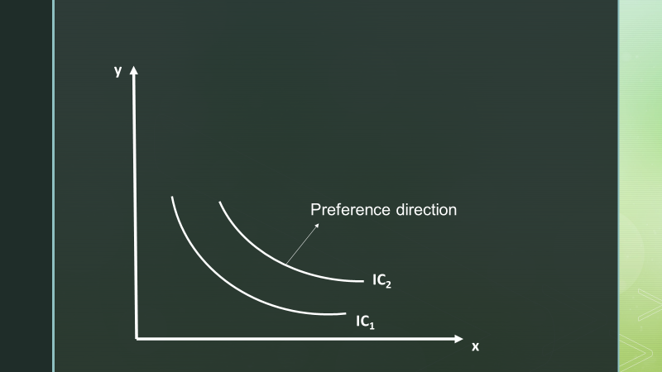

Indifference Curves
Curve where the points represent a combination of items when the consumer at indifference situation (satisfaction). Both axes refer to the quantity of goods. For the combination that produces a higher level of satisfaction, the curves shift to the right (IC₂) from the first curve (IC₁). Indifference curves have negative slope because ot the marginal rate of substitution between goods

Slide 58
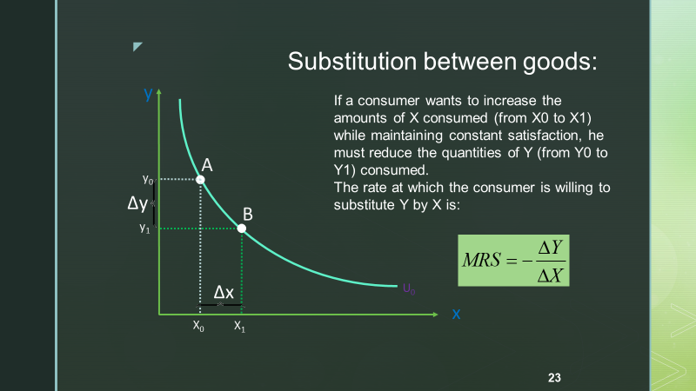
Indifference Curves
Indifference curves have negative slope because of the marginal rate of substitution between goods
Indifference curves are convex. As more of one good is consumed, a consumer would prefer to give up fewer units of a second good to get additional units of the first one.

Slide 59
Group Activity 10 min
Perfect complements: (goods they are consumed together) find some examples. How the indifference curves look like in this case.
Perfect substitutes: (goods you consume the one or the other) find some examples. How the indifference curves look like in this case.
Are the production of goods and services and sustainable environment complements or substitutes? Discuss.

Slide 60
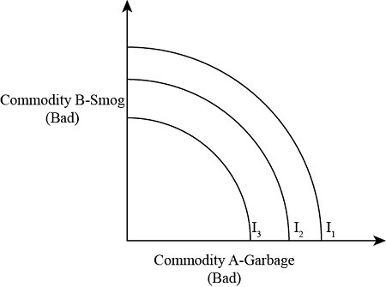
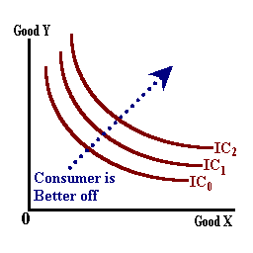
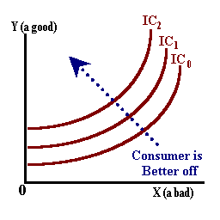
Indifference curves for goods and bads

Slide 61

Group assignment classwork
Work on your group assignment

Slide 62
Profit maximization

Slide 63
Profit Maximization
The Pursuit of Profit Maximization
Profit maximization is a fundamental concept in economics and business that revolves around the objective of maximizing the difference between total revenue and total costs. It serves as a guiding principle for firms seeking to optimize their financial performance and shareholder value. This document provides a simple overview of profit maximization, its importance, and its implications for businesses.
Understanding Profit Maximization: Profit maximization entails identifying the level of output or pricing strategy that generates the highest possible profit for a firm. It involves balancing revenue generation with cost minimization to achieve the greatest net income or profit margin. Firms aim to allocate resources efficiently, produce goods or services at the lowest cost, and generate revenue through sales or transactions.

Slide 64
Profit Maximization
Key Principles:
Revenue Maximization: Firms can maximize profit by maximizing revenue, which involves increasing sales volume, market share, or price levels. Strategies such as product differentiation, marketing campaigns, and pricing optimization can help boost revenue streams.
Cost Minimization: Controlling and minimizing costs is essential for profit maximization. This includes managing production costs, overhead expenses, labor costs, and supply chain costs to ensure efficient operations and resource utilization.

Slide 65
Profit Maximization
Implications for Business Decision-Making:
Production Decisions: Firms must determine the optimal level of output that maximizes profit, taking into account production costs, demand levels, and market conditions. Marginal analysis helps identify the level of output at which marginal revenue equals marginal cost, maximizing profit.
Pricing Strategies: Pricing decisions play a crucial role in profit maximization. Firms must set prices that balance consumer demand, competitive pressures, and profit margins. Price discrimination, price skimming, and penetration pricing are common strategies used to maximize revenue and profit.
Investment and Expansion: Profit-maximizing firms may invest in research and development, capital expenditures, and expansion initiatives to increase productivity, enhance competitiveness, and capture new market opportunities. Investment decisions should be evaluated based on their potential to generate long-term profitability and shareholder value.

Slide 66
Profit Maximization
Limitations and Considerations:
Short-Term vs. Long-Term Perspective: While profit maximization is a primary objective for firms, it is essential to consider the trade-offs between short-term gains and long-term sustainability. Investments in innovation, employee development, and corporate social responsibility may incur upfront costs but contribute to long-term profitability and value creation.
Ethical and Social Considerations: Profit maximization should be pursued within ethical and legal boundaries, considering the impact on stakeholders, employees, customers, and society at large. Balancing financial goals with social responsibility and environmental stewardship is crucial for maintaining corporate reputation and sustainability.
Profit maximization is a central goal for firms seeking to optimize financial performance and shareholder wealth. By balancing revenue generation with cost minimization and making strategic business decisions, firms can enhance profitability, competitiveness, and long-term sustainability in dynamic and competitive markets. However, it is essential to recognize the broader implications of profit maximization and adopt a holistic approach that aligns financial objectives with ethical, social, and environmental considerations for sustainable business success.

Slide 67

The market
What is a market?
Describe a market. Where is it located?
What kind of shops are located close to a market?
Demand and supply in the market (consumers and producers)

Slide 68

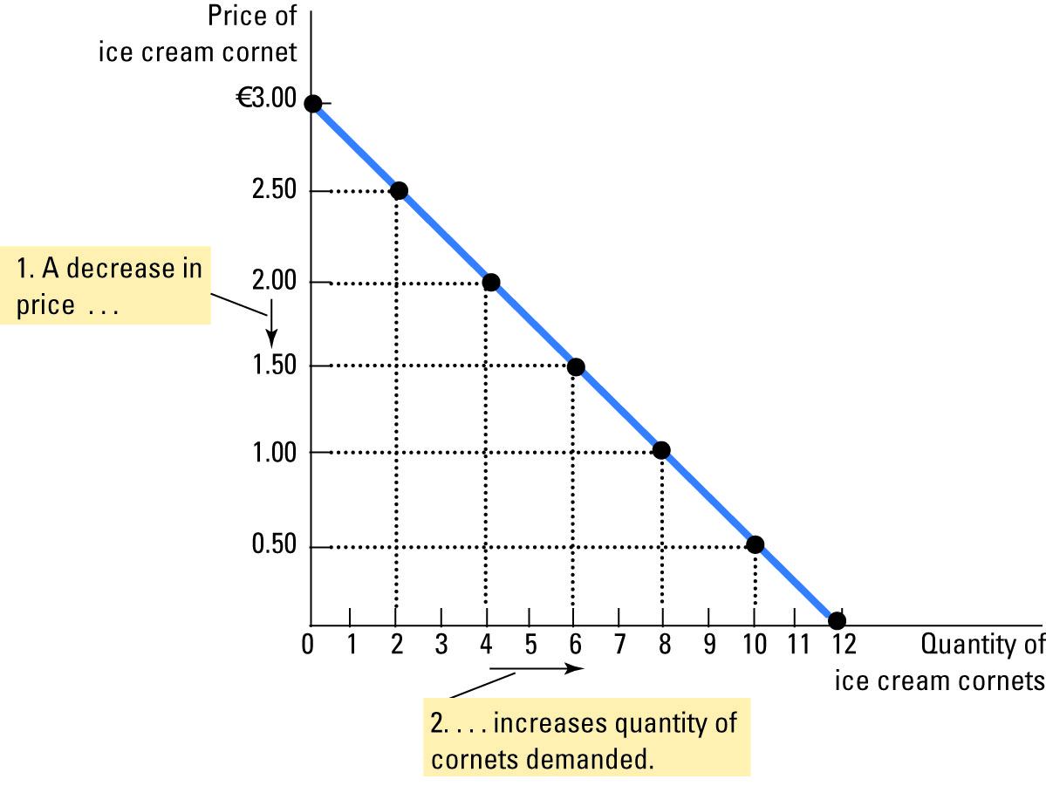
Demand curve
Price | Quantity
0 | 12
0,50 | 10
1,00 | 8
1,50 | 6
2,00 | 4
2,50 | 2
3,00 | 0
Price
A price decrease…
Quantity
2. …increases the quantity demanded

Slide 69
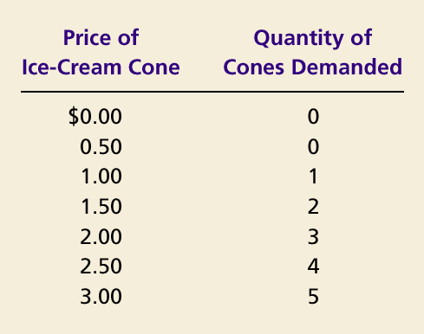
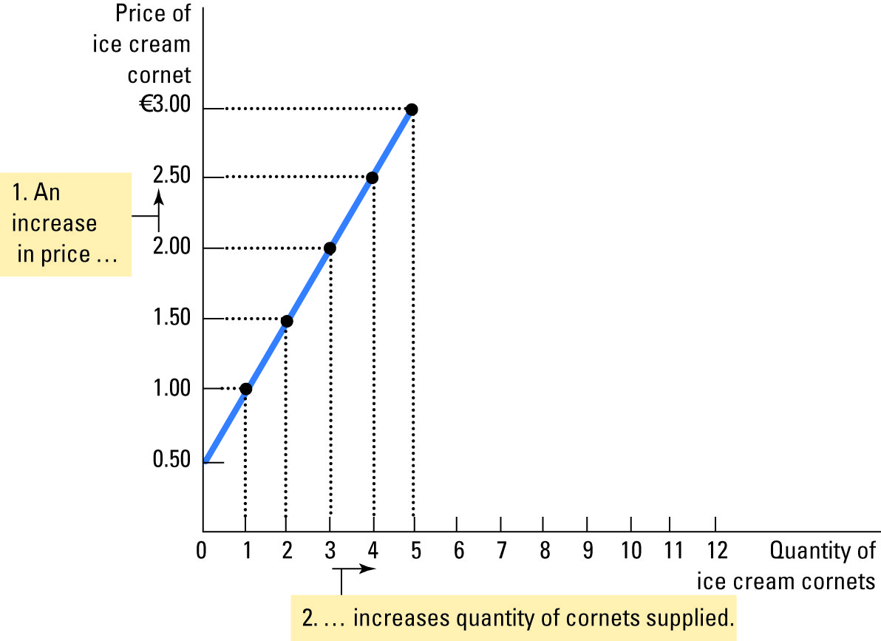
Supply Curve
Price | Quantity
0 | 0
0,50 | 0
1,00 | 1
1,50 | 2
2,00 | 3
2,50 | 4
3,00 | 5
Price
A price increase…
quantity
…increases the quantity supplied

Slide 70
Market equilibrium
Price
Supply
Supply surplus
€ 2.50
2.00
Demand
0
4
7
10
Demanded
quantity
Supplied
quantity
Quantity

Slide 71
Consumer surplus
(consumer surplus at price
P
Price
A
Consumer
surplus
P₁
B
C
Demand
0
Q₁
Quantity

Slide 72
How a change in price affects consumer surplus
(consumer surplus at price
P
Price
A
Initial
consumer
surplus
P₁
C
Surplus for new consumers
B
P₂
F
D
E
Additional surplus for initial consumers
Demand
0
Q₁
Q₂
Quantity
Copyright©2003 Southwestern/Thomson Learning

Slide 73
Producer surplus
Producer surplus at price Ρ1
Price
Supply
P₁
B
Producer surplus
C
A
0
Q₁
Quantity

Slide 74
How price affect producer surplus
(Producer surplus at price Ρ2
Price
Additional surplus
for initial producers
supply
D
E
P₂
F
P₁
B
Initial producer
surplus
C
Producer surplus
for new producers
A
0
Q₁
Q₂
Quantity

Slide 75
Consumer and producer surplices at equilibrium
Price
A
D
Demand
Consumer
surplus
E
Producer
surplus
Supplu
B
C
0
Quantity

Slide 76
Profit in accounting and economics
What are the similarities and differences between economics and accounting?
Economic event and accounting event
Measurement

Slide 77
Economics vs. Accounting
Economics
Accounting
Economic
profit
Accounting
profit
Indirect costs
Revenue
Revenue
Opportunity cost
Direct costs
Accounting
expenses

Slide 78
Opportunity cost
Opportunity costs represent the potential benefits that an individual, investor, or business misses out on when choosing one alternative over another. Because opportunity costs are unseen by definition, they can be easily overlooked. Understanding the potential missed opportunities when a business or individual chooses one investment over another allows for better decision making.

Slide 79
Group Activity 15 min
Give 5 real life examples of opportunity costs

Slide 80

Costs
Q | Total Cost | Fixed cost | Variable cost | Average cost | Average variable cost | Average total cost | Marginal cost
0 | 3,00 | 3,00 | 0,00 | -- | -- | -- | 0,30
1 | 3,30 | 3,00 | 0,30 | 3,00 | 0,30 | 3,30 | 0,50
2 | 3,80 | 3,00 | 0,80 | 1,50 | 0,40 | 1,90 | 0,70
3 | 4,50 | 3,00 | 1,50 | 1,00 | 0,50 | 1,50 | 0,90
4 | 5,40 | 3,00 | 2,40 | 0,75 | 0,60 | 1,35 | 1,10
5 | 6,50 | 3,00 | 3,50 | 0,60 | 0,70 | 1,30 | 1,30
6 | 7,80 | 3,00 | 4,80 | 0,50 | 0,80 | 1,33 | 1,50
7 | 9,30 | 3,00 | 6,30 | 0,43 | 0,90 | 1,38 | 1,70
8 | 11,00 | 3,00 | 8,00 | 0,38 | 1,00 | 1,43 | 1,90
9 | 12,90 | 3,00 | 9,90 | 0,33 | 1,10 | 1,50 | 2,10
10 | 15,00 | 3,00 | 12,00 | 0,30 | 1,20

Slide 81
Cost graph
Cost
€ 3.50
3.25
3.00
2.75
2.50
2.25
MC
2.00
1.75
1.50
ATC
1.25
AVC
1.00
0.75
0.50
0.25
AFC
0
1
2
3
4
5
6
7
8
9
10
Q

Slide 82
Profit maximization

Slide 83
Profit maximization
Marginal revenue (or marginal benefit) is a central concept in microeconomics that describes the additional total revenue generated by increasing product sales by 1 unit.
To derive the value of marginal revenue, it is required to examine the difference between the aggregate benefits a firm received from the quantity of a good and service produced last period and the current period with one extra unit increase in the rate of production.

Slide 84
Profit maximization
Marginal revenue is a fundamental tool for economic decision making within a firm's setting, together with marginal cost to be considered.
In a perfectly competitive market, the incremental revenue generated by selling an additional unit of a good is equal to the price the firm is able to charge the buyer of the good.
This is because a firm in a competitive market will always get the same price for every unit it sells regardless of the number of units the firm sells since the firm's sales can never impact the industry's price. Therefore, in a perfectly competitive market, firms set the price level equal to their marginal revenue

Slide 85
Profit maximization
The marginal revenue (the increase in total revenue) is the price the firm gets on the additional unit sold, less the revenue lost by reducing the price on all other units that were sold prior to the decrease in price. Marginal revenue is the concept of a firm sacrificing the opportunity to sell the current output at a certain price, in order to sell a higher quantity at a reduced price.
Profit maximization occurs at the point where marginal revenue (MR) equals marginal cost (MC).

Slide 86

Externalities

Slide 87
Externalities
Understanding Externalities in Economics
Externalities are a fundamental concept in economics that refers to the unintended consequences of economic activities on third parties who are not directly involved in the transaction. These external effects can have significant implications for market outcomes, resource allocation, and societal welfare. Understanding externalities is crucial for policymakers, businesses, and individuals to make informed decisions and address market failures effectively.

Slide 88
Externalities
Types of Externalities:
Positive Externalities: Positive externalities occur when the actions of individuals or firms generate benefits for others without compensation. Examples include vaccinations, where the immunization of one person not only protects them from disease but also contributes to herd immunity, benefiting the wider community. Other examples include education, research and development, and historical preservation.
Negative Externalities: Negative externalities arise when the actions of individuals or firms impose costs on others without compensation. Pollution from factories, traffic congestion from individual car usage, and noise pollution from construction activities are common examples of negative externalities. These external costs are not reflected in market prices, leading to inefficient resource allocation and societal welfare losses.

Slide 89
Examples of Externalities
Negative Externalities
Pollution
Cell phones in a movie theater
Student cheating that changes the grade curve
Excessive use of antibiotics
Positive Externalities
Research & development
Vaccinations
A neighbor’s nice landscape

Slide 90
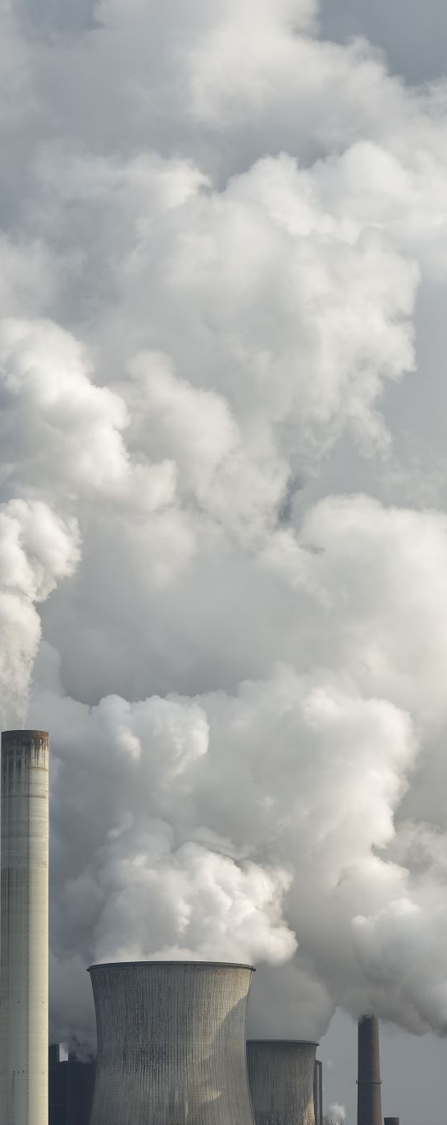
Externalities
Examples of Externalities:
Environmental Pollution: Industrial activities often generate pollution that affects air, water, and soil quality, leading to health problems, ecosystem degradation, and reduced property values for nearby communities. These external costs are not factored into the production costs of firms, resulting in overproduction and environmental degradation.
Traffic Congestion: Individual decisions to drive during peak hours contribute to traffic congestion, leading to longer travel times, increased fuel consumption, and higher accident rates. The negative externalities of traffic congestion impose costs on other road users and society as a whole, reducing overall economic efficiency and quality of life.

Slide 91
Externalities
Implications of Externalities:
Market Failure: Externalities can lead to market failure, where the market equilibrium does not maximize social welfare. In the presence of externalities, market prices do not reflect the true social costs or benefits of goods and services, leading to overproduction of goods with negative externalities and underproduction of goods with positive externalities.
Government Intervention: To address externalities and mitigate market failures, governments often intervene through regulatory measures, corrective taxes, subsidies, or property rights assignments. Environmental regulations, such as emissions standards and pollution taxes, aim to internalize the external costs of pollution and incentivize firms to adopt cleaner production methods.

Slide 92
Group Activity 15 min
Give 5 examples of positive externalities and 5 examples of negative externalities.

Slide 93
Graphical Analysis: Negative Externalities
For simplicity, assume that a chemical firm dumps pollution into a river that harms a fishery.
Competitive markets, firms maximize profits
Note that chemical firm only cares about its own profits, not the fishery’s profits.
Fishery only cares about its profits, not the steel firm’s profits.

Slide 94
Marginal Analysis
Marginal analysis is an examination of the additional benefits of an activity compared to the additional costs incurred by that same activity. Marginal refers to the focus on the cost or benefit of the next unit or individual, for example, the cost to produce one more widget or the profit earned by adding one more worker.
Derivative in mathematics: In mathematics, the derivative of a function of a real variable measures the sensitivity to change of the function value (output value) with respect to a change in its argument (input value). In mathematics, a partial derivative of a function of several variables is its derivative with respect to one of those variables, with the others held constant

Slide 95
Graphical Analysis, continued
Basic Variables
MB = marginal benefit to steel firm
MPC = marginal private cost to steel firm
MD = marginal damage to fishery
MSC = MPC+MD = marginal social cost

Slide 96
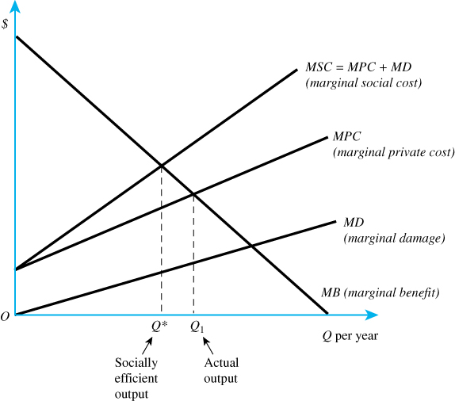

Slide 97
Graphical Analysis, continued
the chemical company maximizes profits at MB=MPC. This quantity is denoted as Q₁ in the figure.
Social welfare is maximized at MB=MSC, which is denoted as Q* in the figure.

Slide 98
Graphical Analysis, Implications
Result 1: Q₁>Q*
Steel firm privately produces “too much” steel, because it does not account for the damages to the fishery.
Result 2: Fishery’s preferred amount is 0.
Fishery’s damages are minimized at MD=0.
Result 3: Q* is not the preferred quantity for either party but is the best compromise between fishery and steel firm.
Result 4: Socially efficient level entails some pollution.
Zero pollution is not socially desirable.

Slide 99
Private Responses
Coase Theorem
Mergers
Social conventions

Slide 100
When Is the Coase Theorem Relevant?
Low transaction costs
Few parties involved
Source of externality well defined
Example: Several firms with pollution
Not relevant with high transaction costs or ill-defined externality
Example: Air pollution

Slide 101
Coase Theorem
The Coase Theorem:
The Coase Theorem, named after the economist Ronald Coase, is a fundamental principle in economic theory that addresses the issue of externalities—costs or benefits that affect third parties who are not involved in an economic transaction. Coase's insights, particularly articulated in his 1960 paper "The Problem of Social Cost," have had a profound impact on the fields of law and economics, as well as policy-making.

Slide 102
Coase Theorem
The Key Concepts of the Coase Theorem
Externalities and Property Rights: Externalities occur when the actions of individuals or firms have unintended side effects on others. Pollution is a classic example, where a factory's emissions affect the health and property of nearby residents. Coase argued that if property rights are well-defined and transaction costs are low, parties can negotiate solutions to these externalities on their own.
Efficient Outcomes through Bargaining: The core of the Coase Theorem posits that if property rights are clearly assigned and transaction costs are negligible, parties will bargain to correct the externality and reach an efficient outcome regardless of the initial distribution of rights. For instance, if a factory causes pollution that affects nearby homes, the homeowners and the factory owners can negotiate compensation or other arrangements to mitigate the pollution.
Invariance Principle: The theorem suggests that the final allocation of resources will be efficient and invariant to the initial assignment of property rights, as long as those rights are clearly defined and enforceable. This means that the allocation of resources will be the same whether the factory has the right to pollute or the residents have the right to a clean environment; the bargaining process will lead to the same efficient outcome.

Slide 103
Coase Theorem
Conditions for the Coase Theorem
For the Coase Theorem to hold true, several conditions must be met:
Well-Defined Property Rights: Rights must be clearly defined and enforceable.
Low Transaction Costs: The costs associated with negotiating and enforcing agreements must be minimal. High transaction costs can hinder or prevent effective bargaining.
Rational Behavior: Parties must act rationally to maximize their own utility.
No Wealth Effects: The parties' ability to pay or compensate each other should not significantly alter their preferences or behavior.

Slide 104
Coase Theorem
Despite its elegance, the Coase Theorem has several limitations:
High Transaction Costs: In reality, negotiating and enforcing agreements can be costly and complex, especially when many parties are involved.
Information Asymmetry: Parties may not have equal access to information, complicating negotiations.
Market Power: The presence of monopolies or other forms of market power can distort bargaining outcomes.
Equity Concerns: The theorem focuses on efficiency, not equity. The distributional consequences of bargaining outcomes can be inequitable.
The Coase Theorem provides a powerful lens through which to view the resolution of externalities and the role of property rights in achieving efficient outcomes. While its assumptions may not always hold in the real world, the insights it offers are invaluable for understanding the interplay between legal frameworks, market mechanisms, and economic efficiency.

Slide 105
Individual Assignment classwork
Work on your individual assignment

